Slide 1
Organization and Self-Motivation
CHECKPOINT

Slide 2
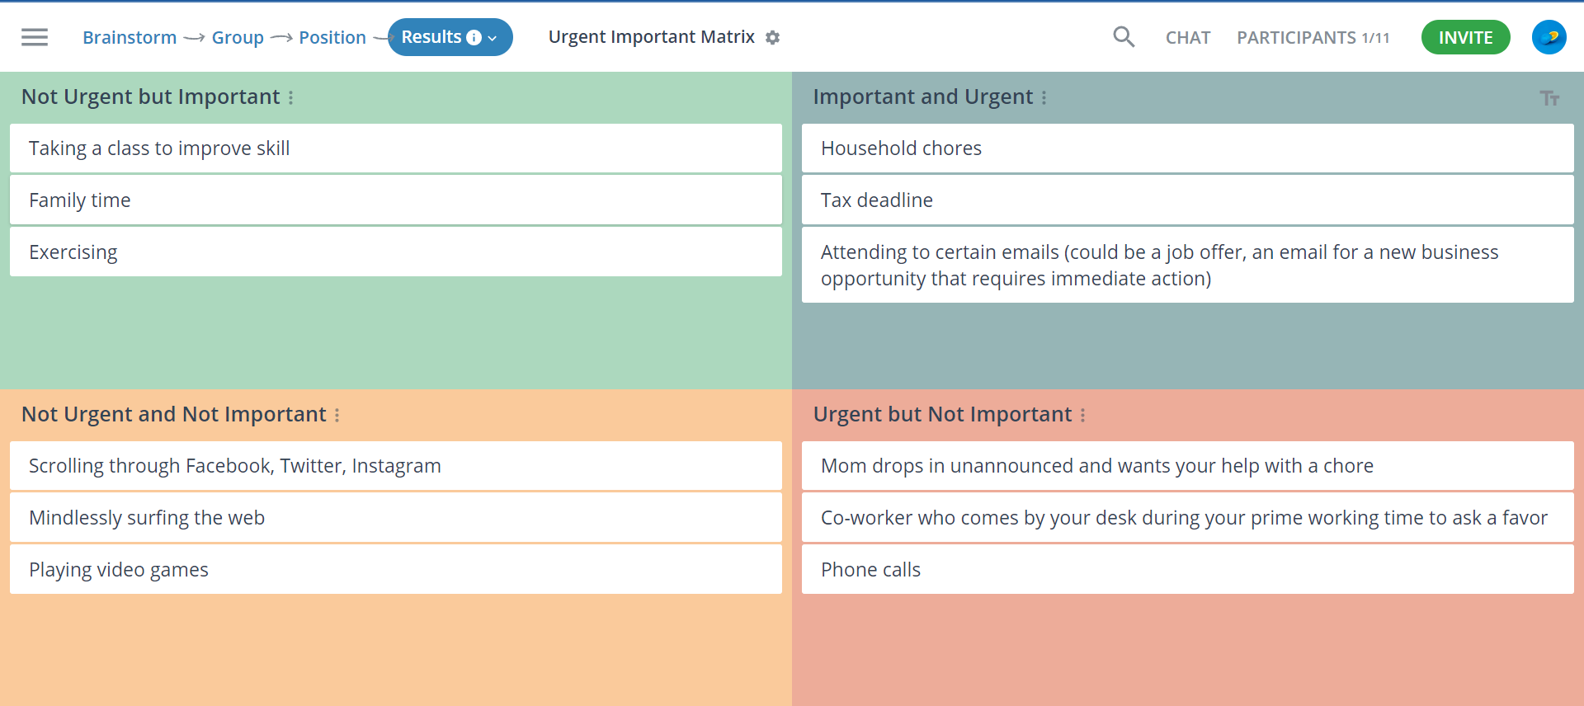
Draw the Urgent Important matrix. Complete the matrix with 3 activities in each box.

Slide 3
Name your goal within one year. Name three sub-goals that will allow you to achieve your primary goal.
Primary goal: Get a well-paying job outside of the country as a full-stack developer.
Sub-goals:
  Build projects and update CV and resume gradually.
  Learn more programming (Frontend and Backend)
  Limit social media & TV

